Slide 1
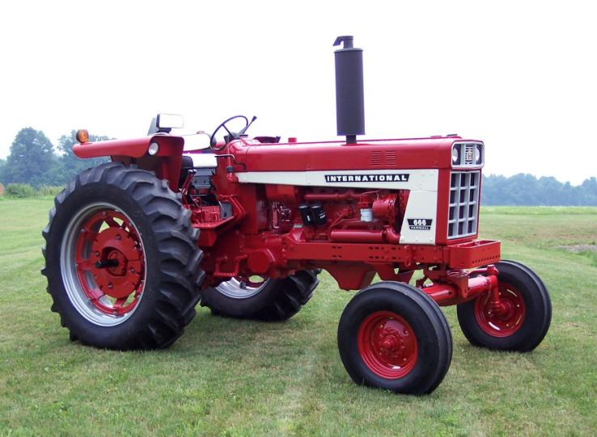
Tractor Safety Introduction
http://www.northottotractorparts.com/restorations/wpcontent/uploads/ih666right-best.jpg
Tractor Safety Introduction
Chapter 1: The Work Environment
Materials in this power point presentation from:
Purdue “Gearing Up for Safety”
https://www.asec.purdue.edu/tractor/index.html
PennState Extension: https://extension.psu.edu/national-safe-tractor-and-machinery-operation-program
Marissa Morton
SAAIP Top Jobs Intern

Slide 2
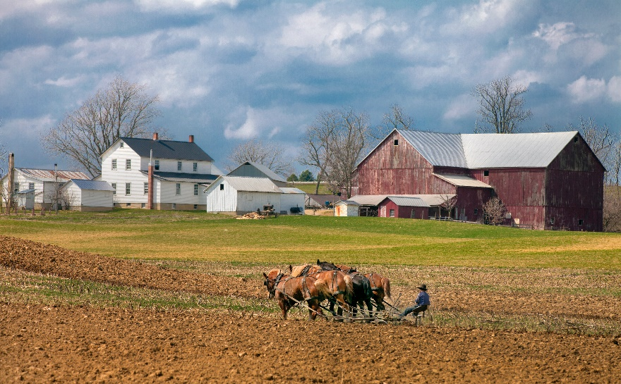
Agriculture today vs. 50 to 100 years ago
How was farming different 50 to 100 years ago?
Activity
What affect have these changes had on agricultural safety/injuries?
Notes:
The next slide shows pictures that depict the differences between agricultural production today versus 100 years ago.
Activity:
Step #1: Pair the students in teams of two
Step #2: Ask each group to identify 3 things that have changed in the way agricultural tasks are performed today versus 100 years ago
Step #3: After each team has had time to write three changes on a sheet of paper, rotate through the groups asking each team to list one item. Continue rotating through the teams until all ideas have been shared. NOTE: As ideas are shared, write them on a whiteboard or blackboard

Slide 3
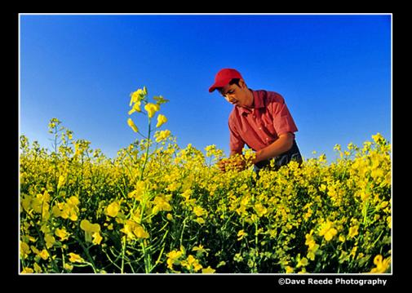
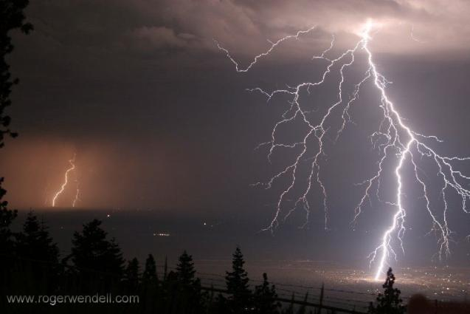
What factors influence farm work and injury risk?
Environmental
Personal
Work Activity
Social, Economic & Political

Slide 4
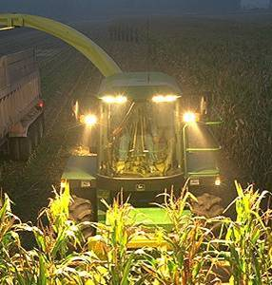
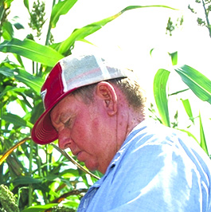
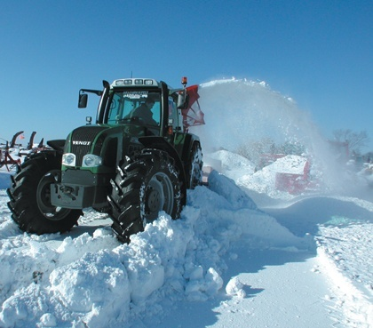
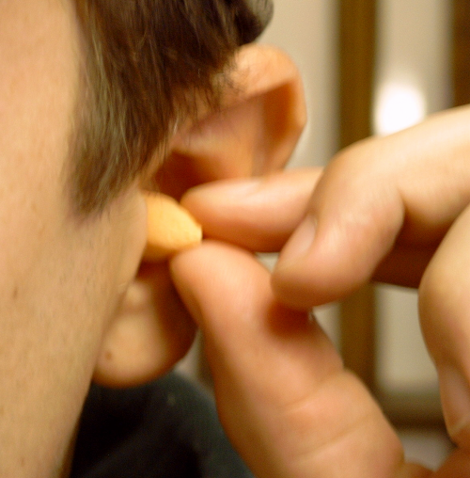
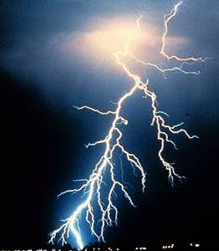
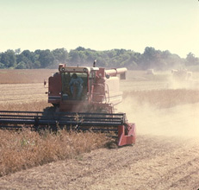
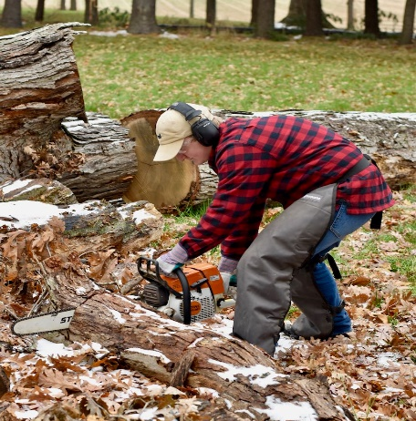
Environmental Hazards that Increase Risk of Injury/Illness during Farm/Ranch Work
Darkness
UV light
Heat/Cold
Noise
Purdue – Gearing Up for Safety
Adverse weather
Dust/Toxic fumes
Vibration
Notes:
Competency 1.10
Identify at least five of the following environmental hazards that can increase the likelihood of injury or disease while performing farm/ranch work
Review the following environmental hazards:
Darkness – Advanced lighting systems permit many farm operations to be carried on 24 hours a day
Sunlight (Ultraviolet rays) – Excessive exposure to sunlight can lead to skin cancer
Heat/cold – Can lead to heat stress or frostbite
Noise - Some machinery produces noise levels that can cause permanent hearing damage
Adverse weather
Snow
Ice
Rain
Lightning
Wind
Tornados
Floods
Fog
Dust/Toxic fumes – Many farm operations create a considerable amount of dust and some produce toxic fumes
Vibration- Some machines expose the operator to considerable vibration that can lead to physical health problems

Slide 5
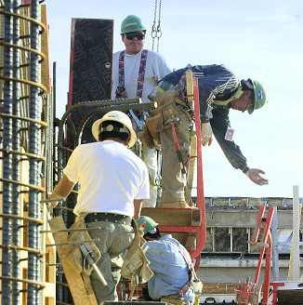
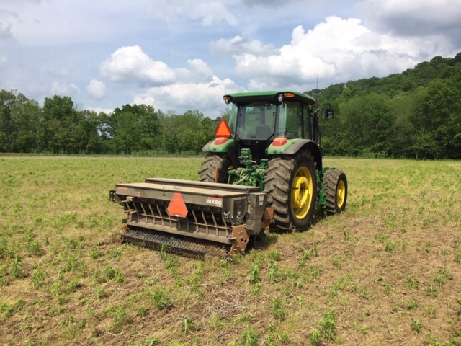
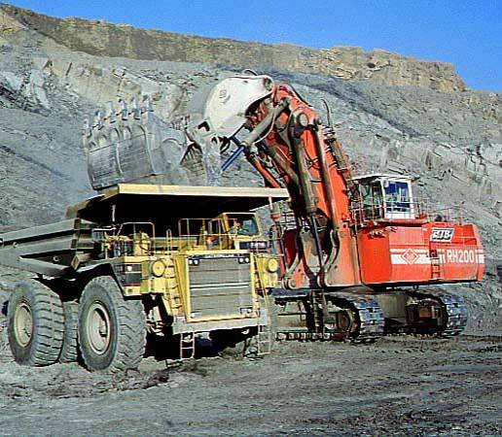
Most Hazardous U.S. Industries
Purdue – Gearing Up for Safety
Construction
Agriculture
Mining
Notes:
Competency 1.1
Compare the ranking of farm/ranch work-related fatalities with other hazardous industries
Discuss the following industries and why each is so hazardous:
1. Mining
Usually the most fatal industry per capita
Fewer miners but incidents often involved multiple fatalities
2. Agriculture
Usually the second most fatal industry per capita
3. Construction
Frequently ranks as the third most fatal industry per capita
Key Points:
Mining, Agriculture, and Construction have been the most fatal occupations in the past decade. In some years the positions change slightly, but no other occupations come even close in the rate of fatal injuries. Check the latest US Bureau of Labor Statistics’ Census of Fatal Occupational Injuries (CFOI) for the most current data.
Agricultural work is getting safer, but not at the same rate as other industries

Slide 6
How many families are affected annually by an agricultural injury/fatality?
1 in families
9
Purdue – Gearing Up for Safety
Notes:
Competency 1.1 continued…
Since agriculture is one of the most hazardous occupations in the United States, a significant number of farm and ranch families are impacted by an agriculturally-caused injury annually. Numerous studies have been conducted at the state and national level to identify the:
age and gender of the person injured
source of the injury (i.e., tractor, machine, animal),
action of the injured person at the time of the injury (i.e., dismounting tractor, climbing ladder, using ATV to check on animals),
nature of the injury (i.e., cut to hand, difficulty breathing, amputated arm)
severity of the injury (i.e. trip to the doctor’s office, emergency room visit, hospital admittance and stay)
Through these studies it has been discovered that approximately one in every nine farm/ranch families will have a member of their family who will be injured in a farm/ranch incident where it will be necessary for that person to be treated by a medical personnel at either a doctor’s office, in an emergency room or at a hospital. The injury may be such that the person is able to return home immediately after treatment or the injury may require that they spend multi-days in a hospital.

Slide 7
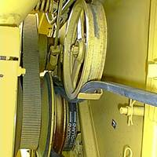
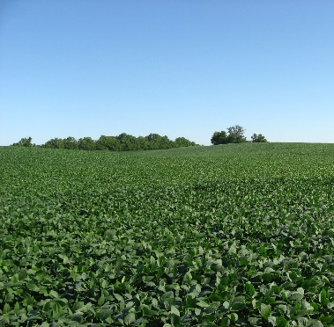
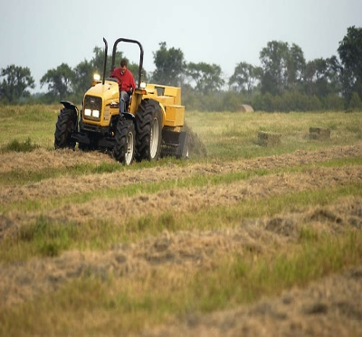
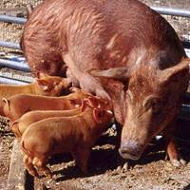
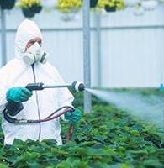
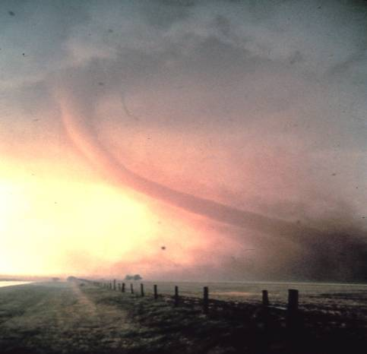
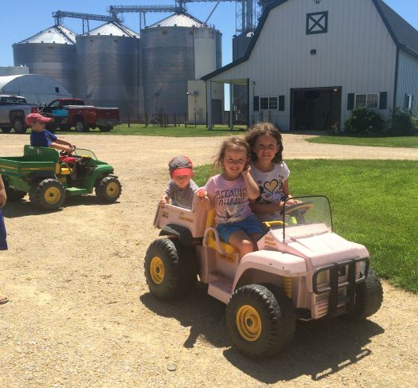
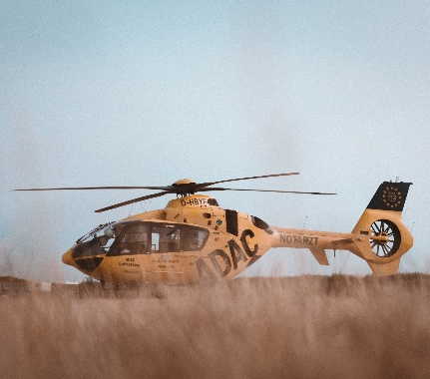
Farm/ranch work is hazardous. What hazard is depicted by each picture?
Hazardous machinery
Isolated workplaces
Working alone
Diverse workforce
Unpredictable animals
Activity
Purdue – Gearing Up for Safety
Agricultural chemicals
Adverse weather
Work and home same location
Limited access to medical services
Notes:
Competency 1.2
Identify at least five of the following reasons why farm/ranch work is so hazardous
Activity:
Step #1: As each image appears, ask students to propose what hazard is identified by the picture
Step #2: Clicking again will reveal the answer
Review the following characteristics: (See Classroom Activity 1.1)
Exposure to hazardous machinery
By the nature of the work being performed, agricultural machinery needs to be powerful and aggressive
Machines are hazardous if workers do not follow the operator’s manual
Isolated worksites
Lack of communication Key points
Workers often work alone 1. Few applicable safety regulations
Possibly for long periods of time 2. OHSA only regulates farms with 11 or
Diversity of workforce, especially age more employees or a temporary labor
Many farmers/ranchers do not retire at age 65. camp
Many children work for their parents at a very young age 3. Few sources of safety-related
Exposure to large and/or aggressive animals information
Livestock are a leading cause of non-fatal farm-related injuries
Animals can be unpredictable. Animals have feelings and suffer from hunger, thirst, fear, abuse, illness, injury.
Exposure to toxic chemicals, dusts, and gases
Agricultural chemicals are heavily regulated, but widely used
Agricultural workplaces contain numerous hazardous environments including silos, manure pits and rotary mowers
Exposure to adverse weather
Workers are exposed to extreme heat and cold and other severe environmental conditions
When bad weather approaches workers are in a hurry trying to complete as much of the farm tasks as possible
Worksite and home site often the same location
The back yard includes the farm yard; children play in areas that could be harmful or fatal
There is not a clear division between the work area and living space
Limited access to emergency services
Farms are located in rural areas and worksites are located away from phone access. Cellular connectivity is limited in some rural locations. Travel time to reach injury site with medical services reduce the likelihood of survival in severe cases

Slide 8
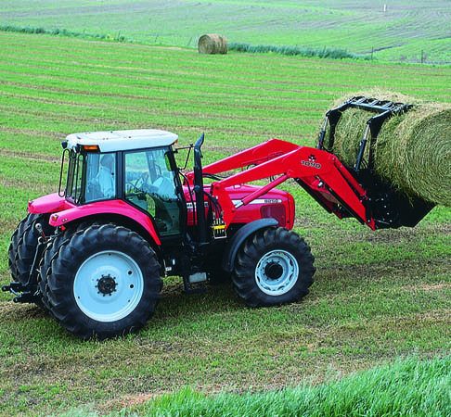
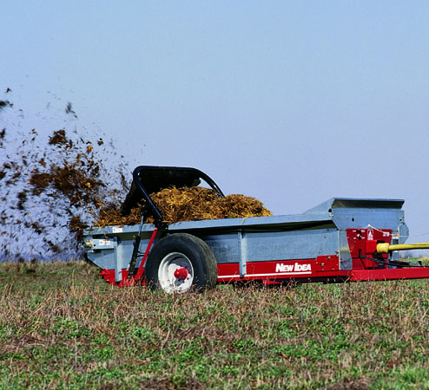
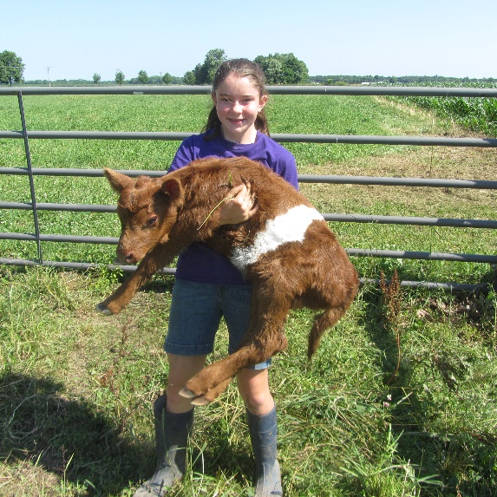
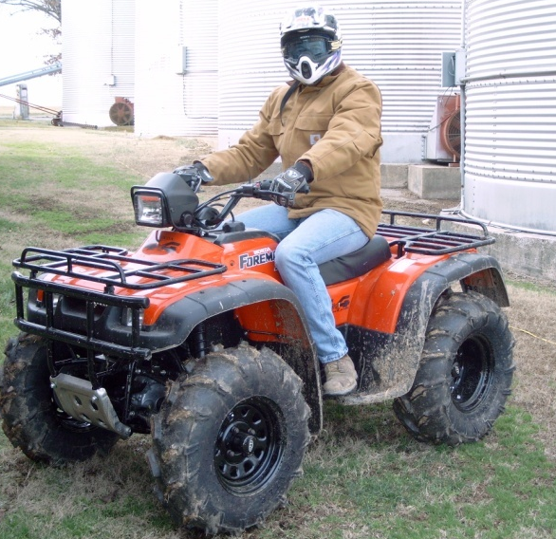
Activities Frequently Involved in Farm/Ranch Injuries
Tractor
operation
Machinery operation
Purdue – Gearing Up for Safety
Livestock
handling
Operating/
Transporting vehicles
Notes:
Competency 1.3
Identify the following types of hazards that are most frequently involved in fatal and disabling farm/ranch injuries
Hazards commonly found on farms and ranches include:
1. Tractor operation
Tractors account for the largest number of fatal farm injuries.
Rollovers (28% of all fatalities) – primarily sideways overturns
Runovers (approximately 10% of all fatalities) – primarily involving extra riders
PTO entanglements (approximately 3% of all fatalities)
2. Machinery operation (Combines, balers, pickers)
Entanglement in the PTO driveline and other operating components
Runovers
Crushing injuries from collapsed components
3. Livestock handling
Kicks
Trampling
Bites
4. Operating or being transported in trucks and other vehicles
Falls
Runovers
Collisions

Slide 9
Why are youth at greater risk of injury during farm/ranch work?
Lack of knowledge
about hazards
Lack of coordination
Lack of experience
Activity
Purdue – Gearing Up for Safety
Physical size
Lack of maturity
Lack of strength
Lack of endurance
Notes:
Competency 1.6
Identify at least five characteristics of youth that cause them to be at greater risk of injury while performing farm/ranch work
Activity:
Calling on the students one at a time, ask each student to cite one characteristic which may make youth more susceptible to a farm/ranch injury
Review the following characteristics of youth: (See Classroom Activity 1.3)
Lack of knowledge about hazards
Farm parents may incorrectly assume children understand how to operate machinery
Insufficient safety training may be provided by family
Greater risk takers
Lack of coordination
Hand/eye coordination develops through growth and maturity
Greater risk of falls
Lack of experience
Youth that live on farms may not receive proper training and supervision
Non-farm youth may have no experience at all
Physical size
Operator seats, steering wheel, and other controls may not accommodate a small operator
If youth can not reach the clutch or brakes, they should not be permitted to operate the equipment
May not be seen by other operators
Lack of maturity
Youth may know how to do a task but lack skills required to think “safety”
Lack of strength
May over-estimate their own strength
May not have the physical strength to perform some tasks
Do not have adequate strength to “hang on” over rough ground
Lack of endurance
Younger children have less endurance

Slide 10
Keeping Farmers / Workers Safe
To keep youth safe, HOOA was written in 1969
Hazardous Occupation Orders for Agriculture
There are penalties for employers that subject youth to hazardous occupations
There are other agencies that help keep workers safe:
OSHA (Occupational Safety and Health Administration) Crated Health Act in 1971
If a farm employs less than 10 people, OSHA cannot inspect these farms
If a farm operator uses only their own labor or their own family labor, OSHA does not have jurisdiction in the operation

Slide 11
Keeping Farmers/workers Safe
Worker Protection Standard (created by EPA)
Practices aimed at reducing the risk of pesticide poisonings
Worker Compensation Laws
$ that is paid into a “fund” incase someone gets hurt while employed
Since the fees are pricey, it is important for workers to be trained in safety practices and have a safe “work attitude”.

Slide 12
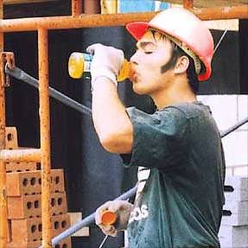
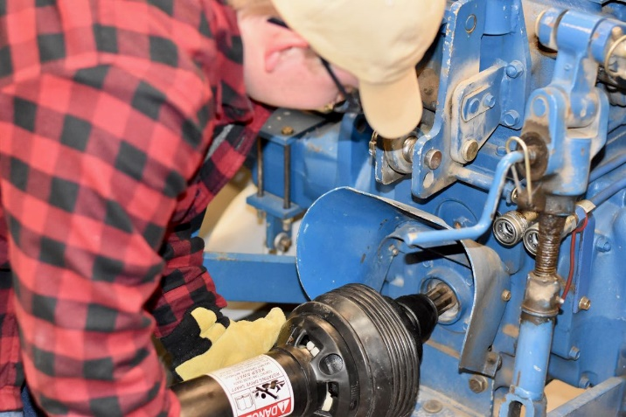
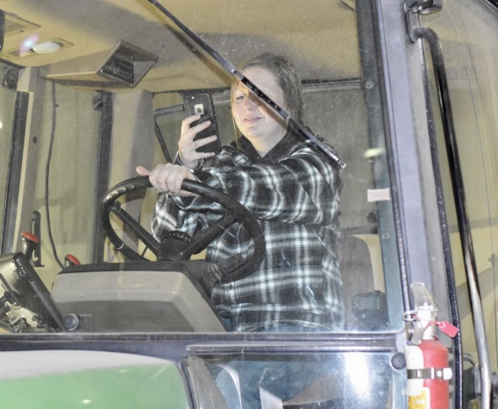
Operator Characteristics that Increase Risk of Injury when Operating Ag Machinery
Emotions
Lack of knowledge/experience
Fatigue
Drugs, medication and
alcohol
Preoccupation
Notes:
Competency 1.7
Identify at least three of the following operator characteristics that contribute to an increased risk of injury when operating agricultural tractors and machinery
Characteristics of operators that may be hazardous include:
Extreme emotions
Operators may not be able to handle the frustrations and emotions associated with learning the proper operational procedures, or may be distracted by events in their lives
Lack of knowledge/experience
Operators need to be confident and focused on the task at hand. This comes with experience and knowledge of equipment
Many younger operators have not worked long enough to gain knowledge and experience to be good operators of equipment
Supervisors may have unrealistic expectations for the workers being supervised
Fatigue
Some operators have short attention spans and get tired or bored easily. Some can not work in the heat of the day for a long period of time without frequent breaks for rest
When working on a farm or ranch, the work day is long, especially during peak periods of planting and harvest. Some workers may not be responsible enough to get appropriate rest and arrive at work tired
Influence of drugs or alcohol
Operators need to be free from influence of alcohol and/or drugs
Alcohol and drugs severely impair judgment and reduce the ability to make clear decisions
Preoccupation
Operators must concentrate on their actions and must not be distracted by things that can cause mental lapses
If several youth are involved with a task the potential for distraction is high

Slide 13
What can I do, as a youth worker on a farm?
What is your age?
Unless employed by a parent or legal guardian, the order prohibits youth under the age of 16 from the following tasks (no exemptions):
Driving a vehicle to transport passengers or riding on a tractor as a passenger or helper
Working inside certain agricultural storage structures with hazardous atmospheres or packing a horizontal silo
Working with toxic agricultural chemicals
Handling or using explosives and anhydrous ammonia
Youth 14 and 15 years of age who complete an approved tractor and machine operations training program could be exempted from certain portions of the regulation.
Operating a tractor of over 20 PTO horsepower or connecting or disconnecting an implement or any of its parts to or from such a tractor

Slide 14
Youth 14 and 15 years of age who complete an approved tractor and machine operations training program could be exempted from certain portions of the regulation (con’t.)
Operating or assisting to operate any of the following machines:
Corn picker, cotton picker, grain combine, hay mower, forage harvester, hay baler, potato digger, or mobile pea viner
Feed grinder, crop dryer, forage blower, auger conveyor, or the unloading mechanism of a non—gravity type self unloading wagon or trailer
Power post hole digger, power post driver, or non-walking rotary tiller
Workers Younger than Age 14
Cannot be hired by an Ag Employer to complete jobs declared hazardous by the Department of Labor.
When a federal regulation and a state regulation conflict, the most stringent regulation is enforced.

Slide 15
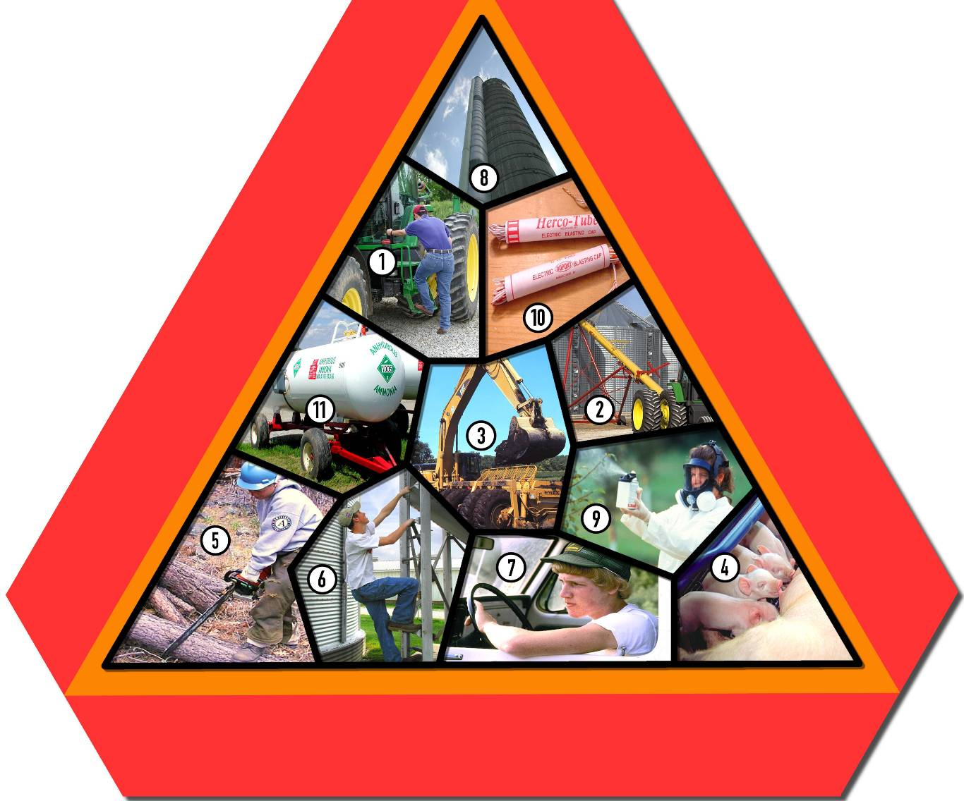
What specific tasks are prohibited by the FLSA for youth under 16?
Working inside toxic atmospheres or confined spaces (silos, grain bins, manure pits, tanks, fruit storage)
Activity
Operating tractors over 20 PTO hp.
Handling or using a blasting agent (explosive)
Transporting, transferring, or applying anhydrous ammonia
Operating PTO-operated machinery
Handling or applying restricted use chemicals
Operating specialized powered machines
Working in wood lots with logs over 6 inches in diameter
Working with breeding livestock including bulls, boars, and stallions
Working on ladders and scaffolds at heights over 20 feet
Operating a vehicle to transport passengers or riding on a tractor as a passenger
Notes:
Competency 1.14
Identify the 11 specific farm/ranch tasks that have been identified by the Fair Labor Standards Act (FLSA) as being particularly hazardous for youth under 16, and identify which can be performed with training and which are considered too hazardous for any youth under 16
Activity:
Have the students match the following numbered tasks with those shown on the visual
Can be performed with appropriate training:
Operating tractors over 20 PTO hp
Operating PTO-operated machinery
Cannot be performed for hire until age 16:
Operating specialized powered machines
Working with breeding livestock including bulls, boars, and stallions
Working in wood lots with logs over 6 inches in diameter
Working on ladders and scaffolds at heights over 20 feet
Operating a vehicle to transport passengers or riding on a tractor as a passenger
Working inside toxic atmospheres or confined spaces (silos, grain bins, manure pits, tanks, fruit storage)
Handling or applying chemicals
Handling or using a blasting agent (explosive)
Transporting, transferring, or applying anhydrous ammonia
Some of these tasks will be discussed further in Lesson 15

Slide 16
Take Away Points
Agriculture has changed a LOT over the years!
There are four factors that make it difficult to improve safety on the farm.
Labor Laws (to protect youth workers) were implemented in 1969 Hazardous Occupations Order in Agriculture
*this law has specifics for youth workers (under 16, 14-15 years old, and under 14).
*Employers can be fined if they do not follow these laws. BUT – if you work for your parent/guardian then there are exemptions!

